Slide 1
Tendermint
Notes:
This slide is for the beginning
Thank BNY for providing us with the space
Thank Yiseul for organising the event
I will tell you about Tendermint, what we are building and how you can benefit from it
It will only be a very brief glimpse into the future of blockchains and its underlying technology

Slide 2

Who am I?
Adrian Brink
Core Developer @ Tendermint
Background in Software Engineering/Development and Business Management
Lived and worked in Denmark, Canada, Germany, and the UK
Avid drone enthusiast
Research interest:
Consensus Engines
E-voting
Gambling
Usability
Notes:
- Quick introduction about myself to get the audience warmed up

Slide 3
Let’s start with questions
Who has heard / knows about Tendermint || Ethermint || Basecoin?
Notes:
- Questions to get a feel for their understanding

Slide 4
Let’s start with questions
Who has installed / used any of the previous programs?

Slide 5
Let’s start with questions
Who has tried to use any of our testnets?
Notes:
Venus, Hermes or Mercury

Slide 6
Let’s start with questions
Who has managed to send some coins between the two separate Basecoin blockchains?
Notes:
- Highlight that if no one has done that, that is okay, because we will have a small demo and get everyone going

Slide 7










Who’s behind Tendermint?
The core team of 10 (and growing) amazing people
Notes:
- Make the company more human

Slide 8
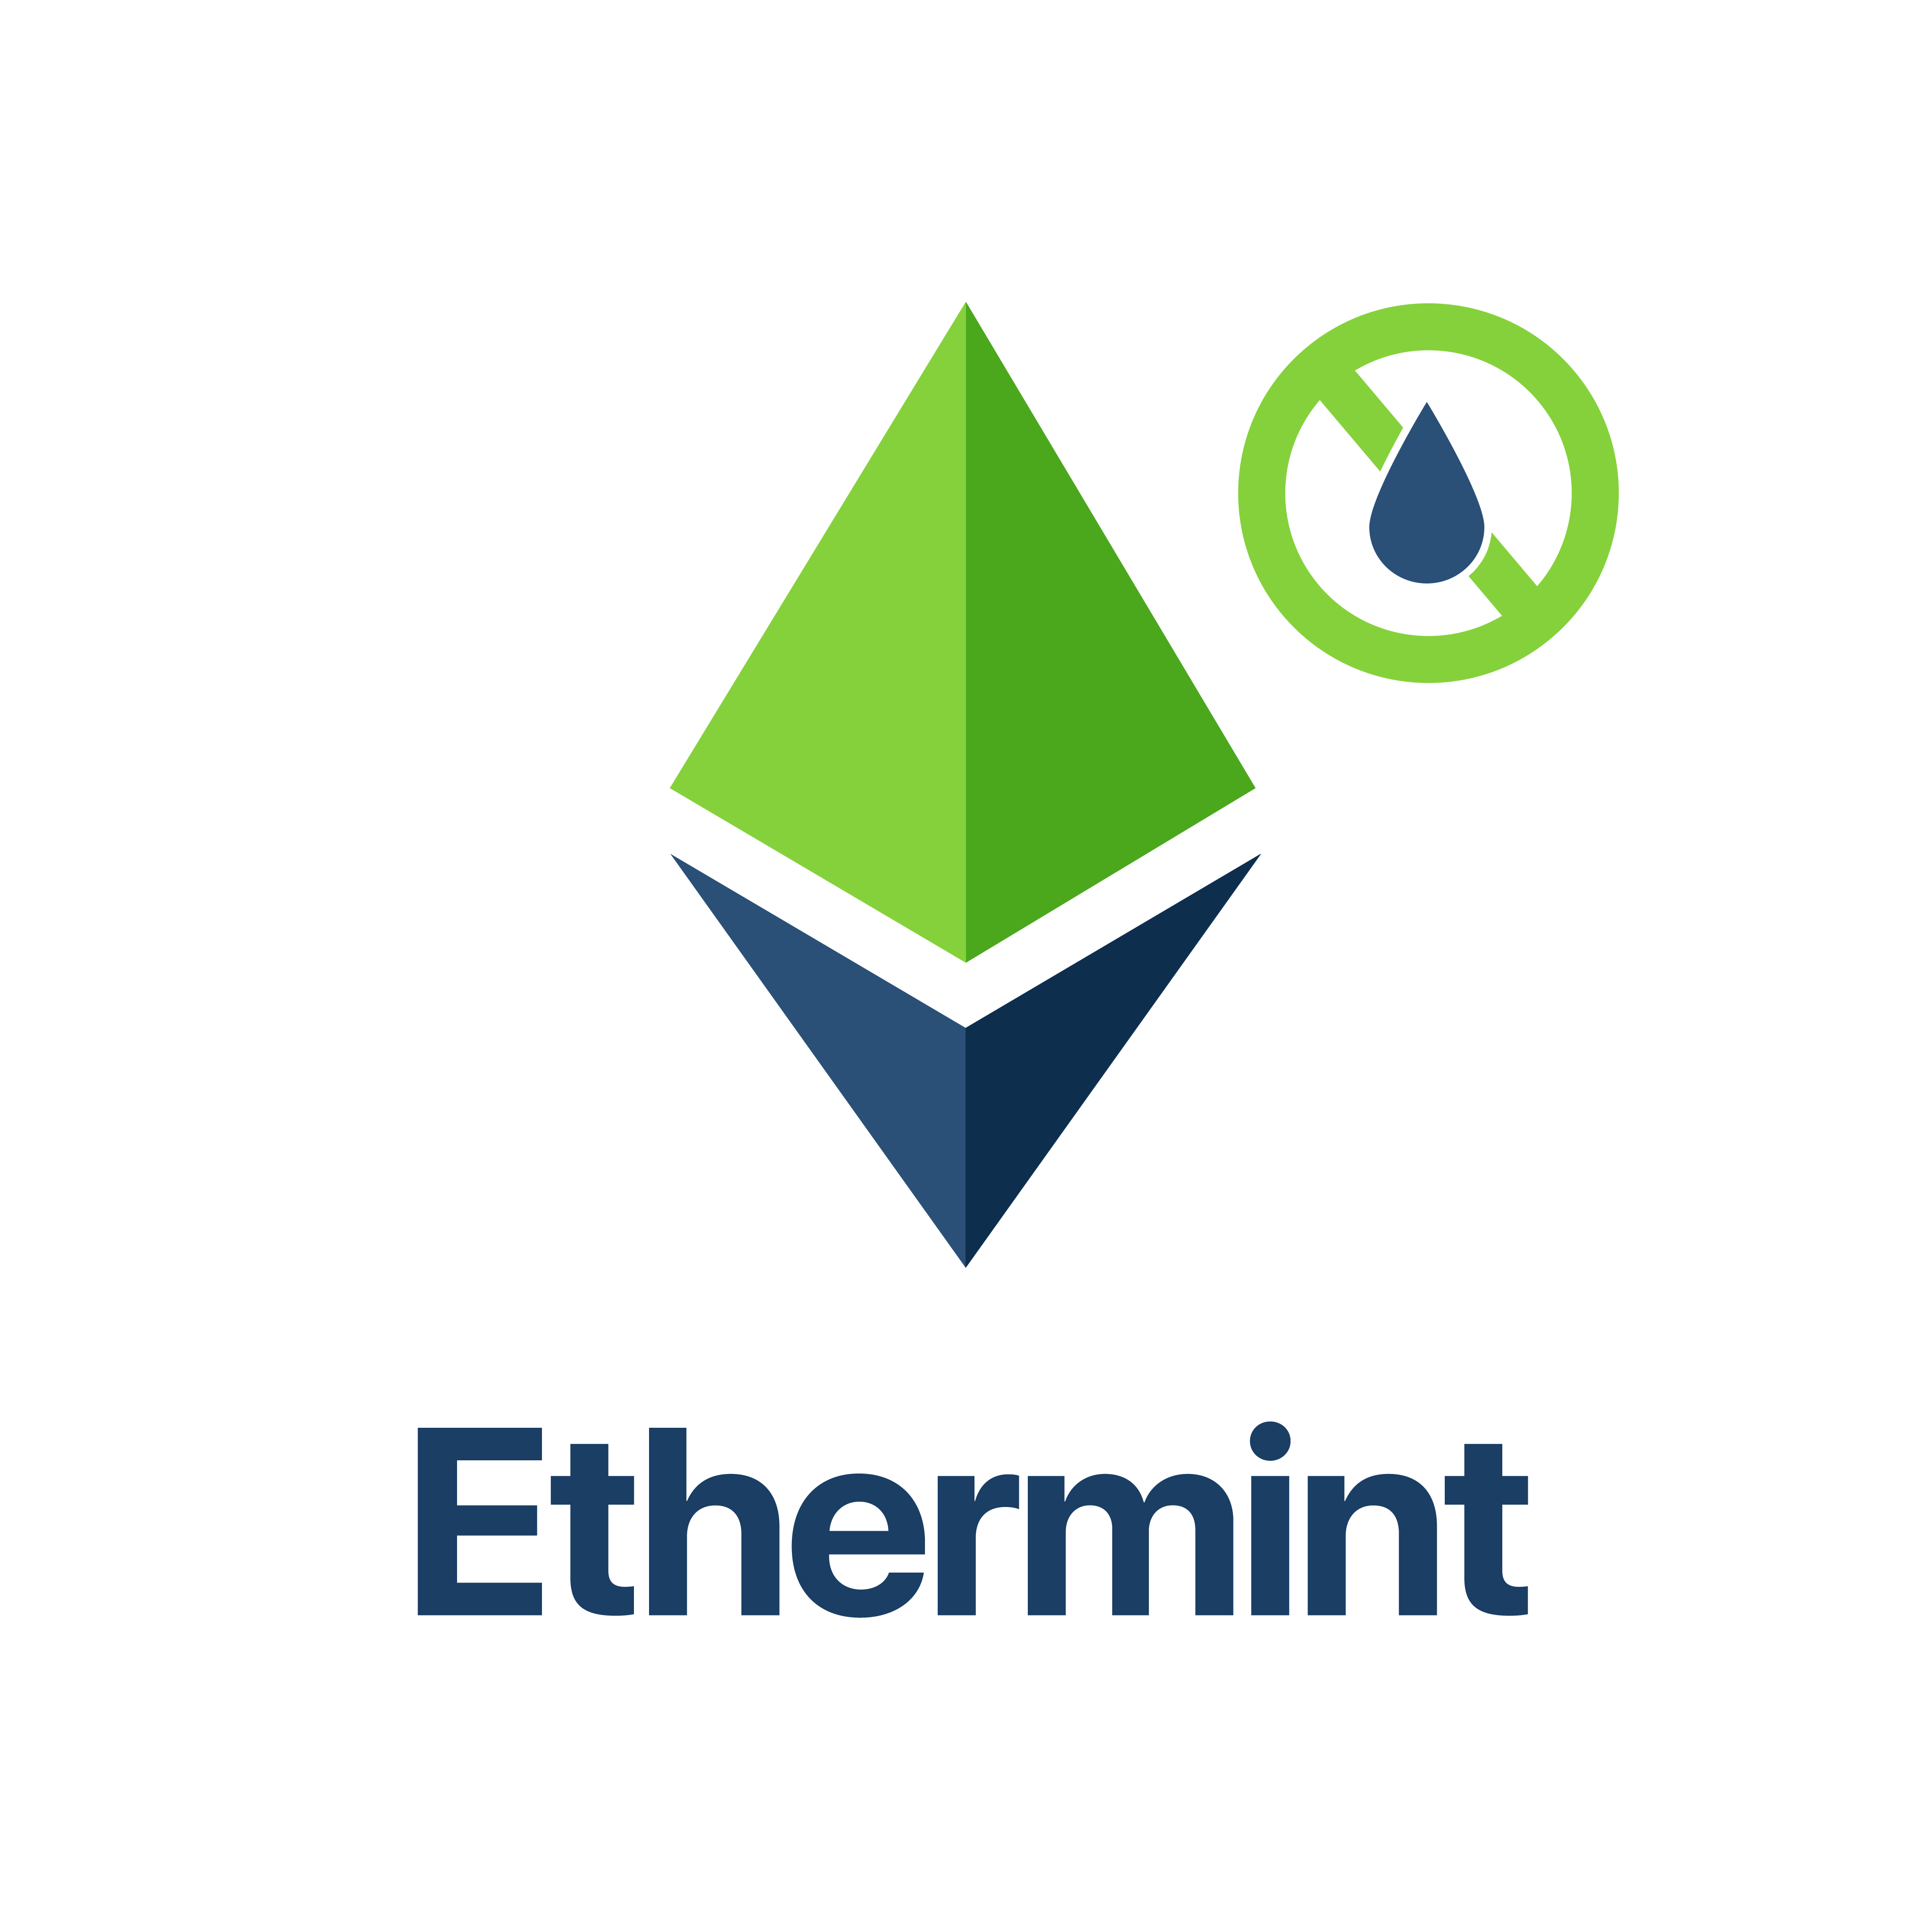

My work at Tendermint
Tendermint Core
Ethermint
Peg Zones
Rust Support
Enterprise Integrations
Developer Outreach
Notes:
Quickly give them a feeling for my knowledge areas
Elaborate on ethermint and tendermint core

Slide 9
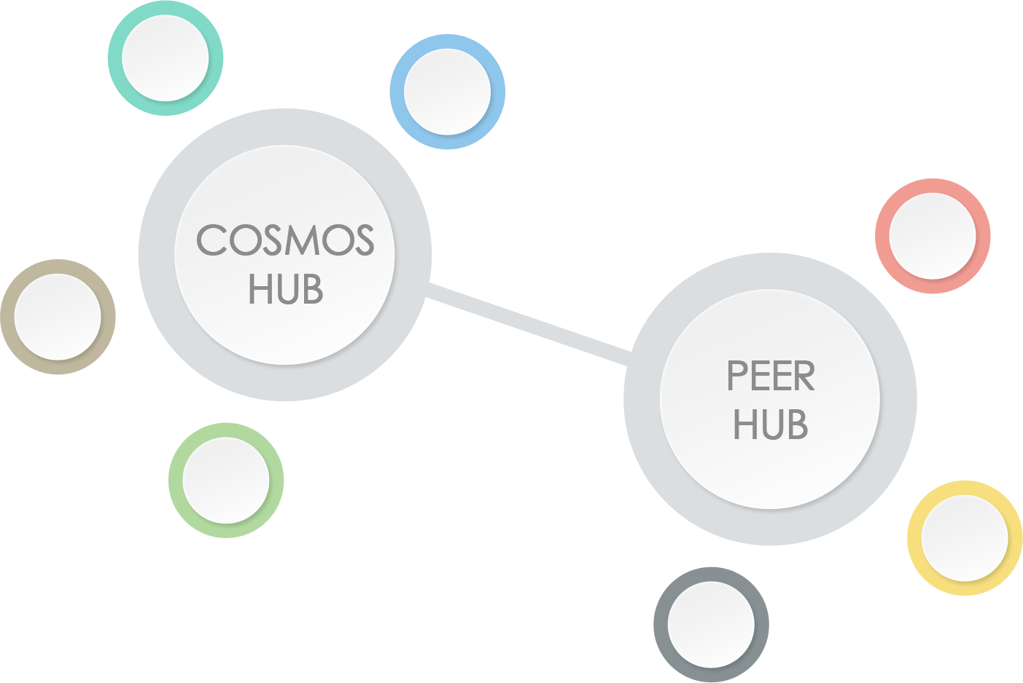
What is the COSMOS hub?
Scalable Cryptocurrency
The COSMOS hub facilitates moving value across different zones and hub
Arbitrary business logic in the application layer
Instead of one to rule them all there will be multiple to work together
Notes:
The COSMOS hub will provide an interoperability layer between different blockchains
Zones such as Ethermint can register with the hub and then move value to the hub and potentially to other zones
Interoperability between blockchains
Example: Once we have a second zone for bitcoin you can seemlessly exchange bitcoins for ethereum on the Cosmos hub
Example: AirBnb tokens

Slide 10
What are we building?
Everything that is needed for the
COSMOS Hub
Tendermint Core Engine
COSMOS Apps
Tendermint Apps
ABCI Protocol
Peg Zones
Decentralised Exchange
Enterprise Solutions
IBC Protocol
Notes:
tendermint is the underlying core engine that implements consensus (PoS) and P2P
Explain the difference between COSMOS apps and Tendermint apps
The core powers both, the difference lies in where the validator set is running
On top of that we are building basecoin
The baselayer for the COSMOS hub
A multi-asset blockchain that stores how many tokens are in each connected zone
Ethermint is the first zone
Provides smart contracts
Provides an EVM
Secured by PoS
Much higher throughput and blocktimes, 20 times faster

Slide 11
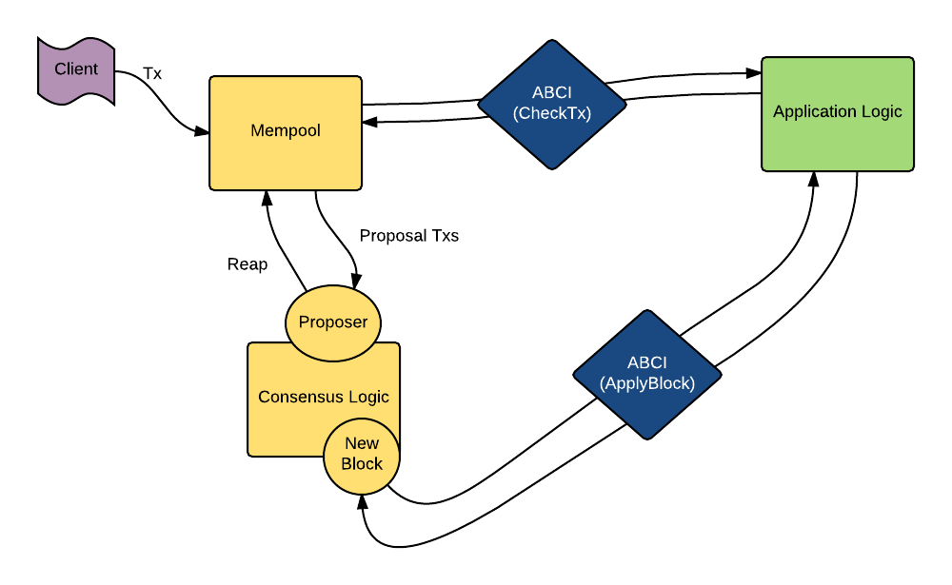
Brief Overview of Tendermint
The Blockchain is secured by Tendermint consensus
Proof-of-Stake algorithm that uses security deposits
Application logic is abstracted away
Arbitrary business logic can be build on top of Tendermint
Standalone Tendermint application can become zones on the COSMOS hub
Notes:
- The network is secured by validators that either deposit money or are verified
Our version of PoS and how it secures the network
Building applications on top of Tendermint
How do zones work? Consensus Engines

Slide 12
Why Tendermint and what makes us different?
Tendermint Core implements a Proof-of-Stake consensus algorithm
Doesn’t waste electricity but rather uses security deposits
Secure and formally verified
Full specification on GitHub
Guarantees safety & liveness through the algorithm and a weak synchrony assumption
Is optimal Byzantine Fault Tolerant
Requires +1/3 byzantine failures to violate safety/liveness
Is fully fork accountable
We can figure out who tried to cheat and punish them
Much simpler than other implementations such as Casper (Ethereum)
Notes:
The entire code base is roughly 25,000 lines of go
It allows you to easily reason about it and verify the implementation
The consensus algorithm is only about 5,000 lines
Bitcoin is also vulnerable to the 1/3 attack

Slide 13
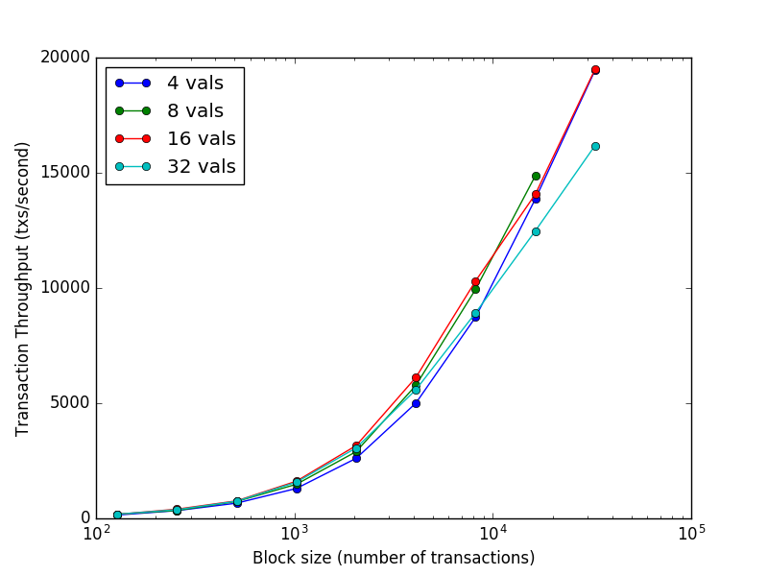
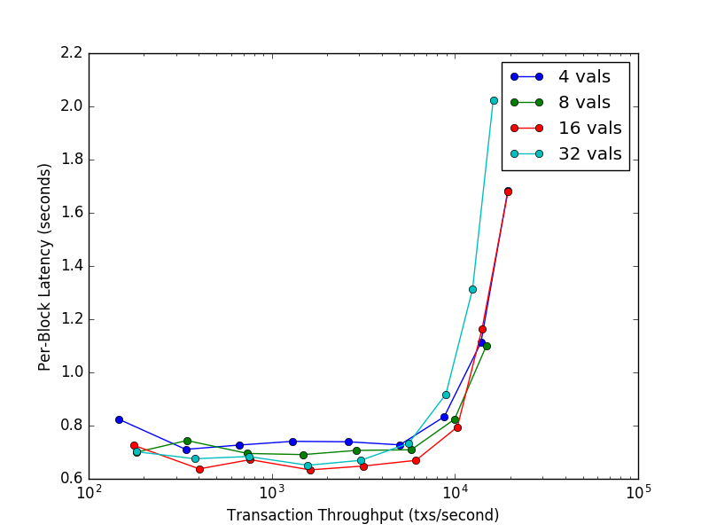
Properties and possible application
7 datacenters on 5 continents (AWS - c3.8xlarge)
Notes:
Transaction throughput scales to roughly 10,000 transactions per second
We can increase the throughput through optimisations
We are also offering enterprise solutions

Slide 14
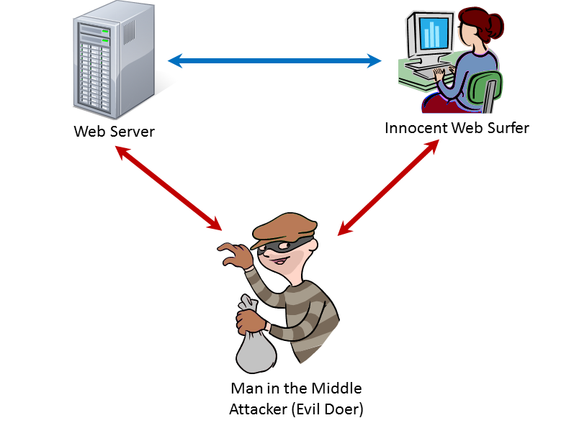


Properties and possible application
Fast and permanent block finality
Efficient light clients are available
The validator set is known and accountable
Regional zones
Notes:
A block is finalised every 1 second and once it is committed it will not change
In PoW chains you normally have to wait up to 12 confirmations before you can be certain that a block has been included
With Tendermint you are certain immediately
In PoW light-clients have to sync at least all the block headers
This means that there is usually a trusted server that provides an up-to-date view into the blockchain
Has all the usual problems of normal databases, it just sounds fancier since it is a blockchain
In Tendermint a light-client has to come online every 30 days and has to trust no server, it can fully verify the chain and the state
A great application can be mobile banking apps that are resistant against Man in the middle attacks
The validator set is known and accountable
With PoW most miners are anonymous and anyone can join the network
With Tendermint PoS the application determines who is allowed to validate blocks and each validator is identifiable

Slide 15
How to write your own business application?
The easiest way is to implement everything on top of Ethermint in solidity
We provide language bindings for Rust, Java, Go, JavaScript if you want to write your own persistent state machine
Implement a couple of required messages, such as Info() and DeliverTx()
Pitfalls:
Tendermint core opens three separate socket connections
Some events can run concurrently, whereas others require sequential execution
Speed is of essence essentially for apps that require larger application states
Light-clients have to be considered from the beginning
Notes:
You have three options
Either write them on top of ethermint as solidity smart contracts, Common Wealth Bank of Australia is doing that
Or write them on top of basecoin, which currently is mostlyl a cryptocurrency layer
Or write your own ABCI app

Slide 16
How to write your own business application?

Slide 17
Questions?

Slide 18
Where to find me?
Adrian Brink
Core Developer @ Tendermint
Twitter: @adrian_brink
Github: adrianbrink
Telegram: adrianbrink
Email: adrian@tendermint.com || adrian@brink-holdings.com
Research interest:
E-voting
Gambling
Usability
Developer on-boarding
Consensus Engines

Slide 19
Extra Resources
Tendermint/COSMOS Whitepaper
Tendermint in a Nutshell
Slack Channel
Epicenter – Podcast
Core Developer Chat Livestreams - Youtube

